Slide 1
Rendering Techniques

Slide 2
Why bother?
You have your project running but it is too slow
Your project is far from finished but you hit the 30 frames
Everything is fine but I would love more detail
At some point you need a completely new look

Slide 3
Strategies
Try to use existing nodes that you can play with which build upon GPU
  Texture effects from UNC
  Multiple Render Target Library from dottore
  Check all the contributions
Not satisfied?
  Then you need to learn how to program GPU

Slide 4
CPU & CPU
Nodes and pretty much everything else in a computer generally is computed by the CPU
Effect / Shader nodes instruct the GPU while serving as a interface to the normal CPU world
GPU is perfect for some repetitive tasks. The pipeline allows you to program certain important bits.

Slide 5
Speed
GPU is fast. It has some many cores.
This speed unfolds best when only few quite complex instructions are made.
Many simple instructions is not that good
DX9 Primitives are instanced by default. But their look is too basic.
EX9 Effects – when spreaded – use one call per slice. So they are not instanced by default

Slide 6
DX 11
Constant versus Constant Indexed

Slide 7
Effect Topics
Spaces
  Object
  World
  View
  Projection (Aspect & Crop included)
TextureSpaces

Slide 8
Effect Topics
Pins versus Semantics
  Global variables without Semantics create pins
  Global variables with Semantics don't

Slide 9
Effect Topics
Shader Types
  Vertex Shader
  Geometry Shader
  Pixel Shader
Together make up an effect
Again: pretty much of the pipeline is fixed

Slide 10
Pipeline
Textures,
Buffers
Input Assembler
Controlled by Topology node
Vertex Shader
Your HLSL code
Geometry Shader
Stream Out
( )
Rasterizer
Controlled by Rasterizer node
Pixel Shader
Your HLSL code
Output Merger
Controlled by Blend node

Slide 11
Geometry
Vertices in a VertexBuffer
    Vertex Position
    Normal
    TexCoords
Layout
    describing which components are used in the Vertices
Indices in a IndexBuffer (optional)
    A Lookup Table for keeping the VertexBuffer small
Topology
    Point
    Line
    Triangle

Slide 12
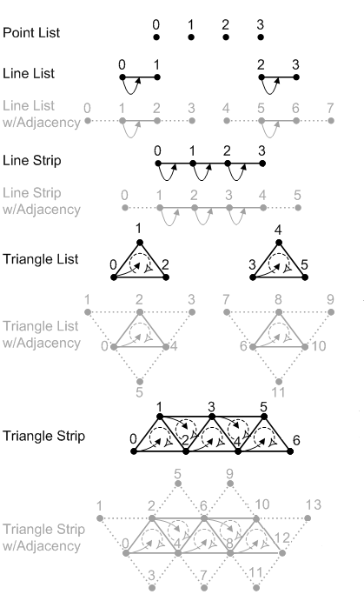
Toplogy

Slide 13
Data Formats (Values → Bits)
Encoding of Real Numbers (Floats)
    R32G32B32A32_FLOAT =
    for Red Green Blue Alpha use 32 bits
Encoding for Real Numbers 0..1 with few bits
    R8G8B8A8_UNorm = for all channels use 8 bits
    00000000 = 0.0 11111111 = 1.0
    This is the standard to encode colors
Encoding for Real Numbers -1..1 with few bits
    …._SNORM
Encoding for Whole Numbers (Integers)
    …._SINT

Slide 14
Data Formats (Values → Bits)
Used to represent the Color in the ColorBuffer of a Renderer
    check the Renderer with the Inspektor
Used to represent Depth Information in a DepthBuffer
    check the Renderer with the Inspektor again
Used to represent Elements of a Vertex in a Vertexbuffer
    check the InputElement node

